Slide 1
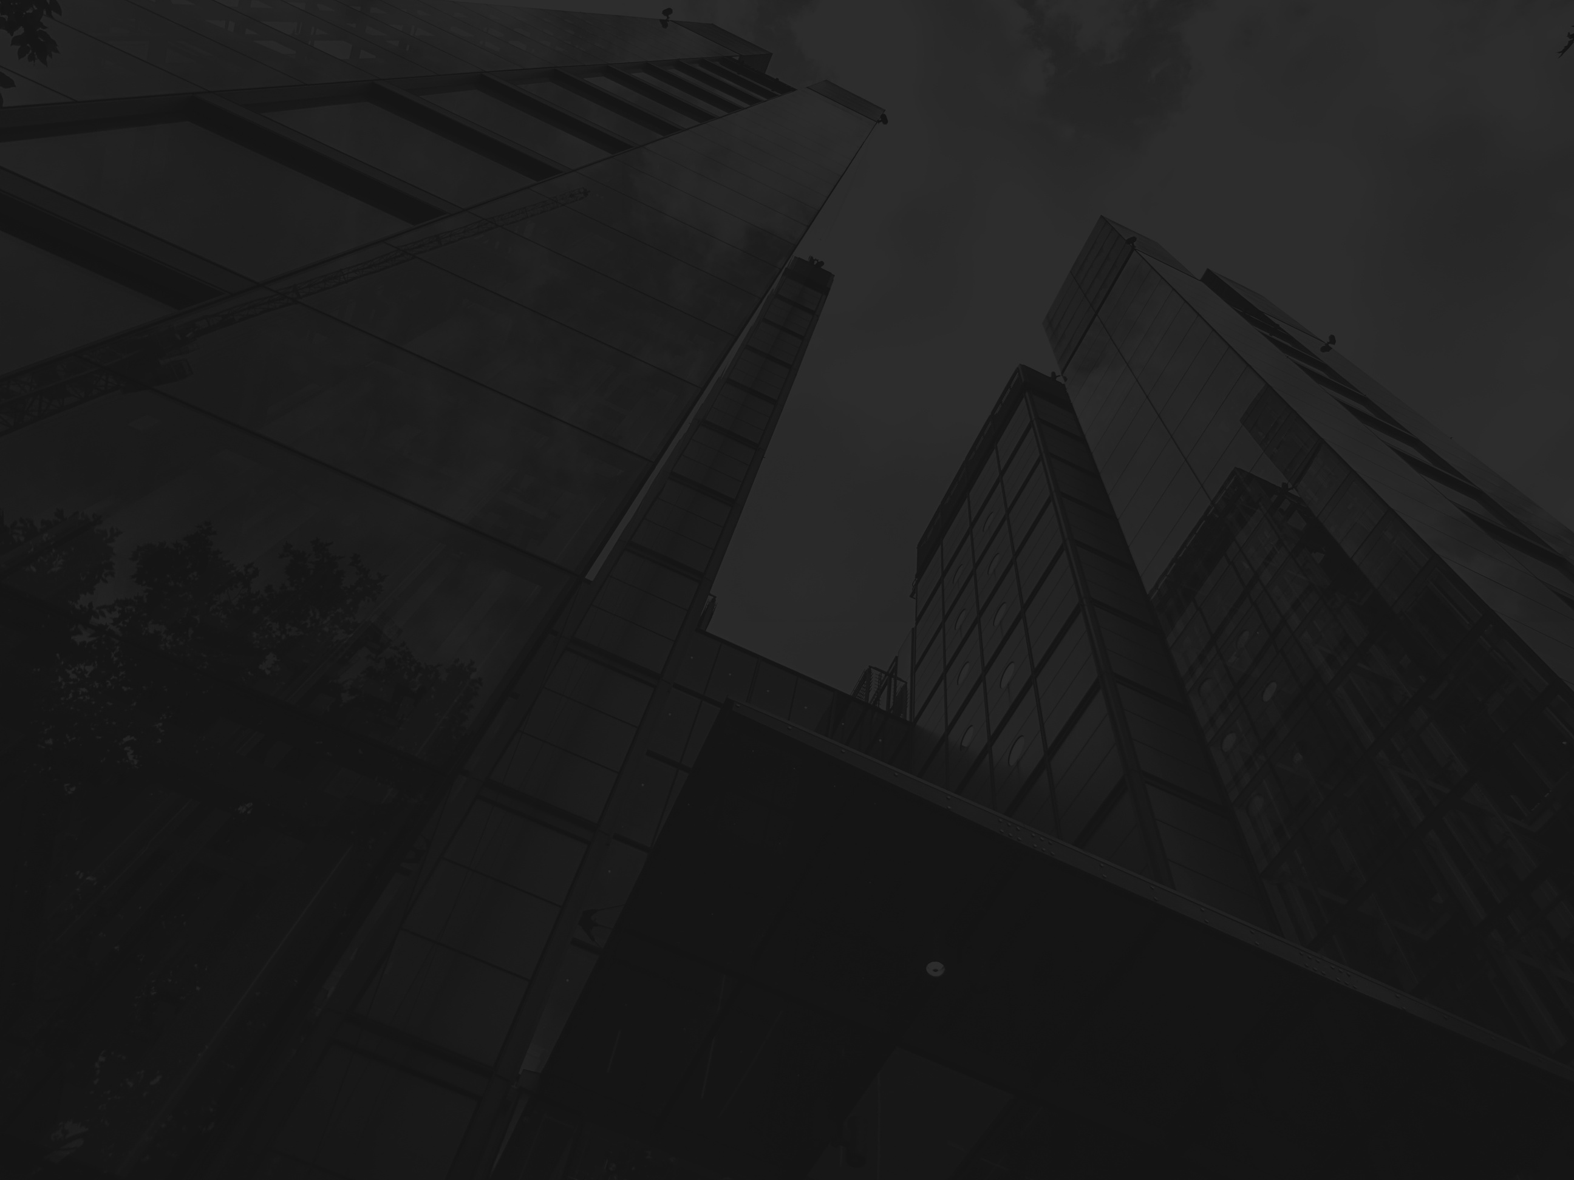

Portfolio projected by
AHMED MAHMOUD
META ADS
STRATEGY
Vision Jeddah Eyewear
01

Slide 2
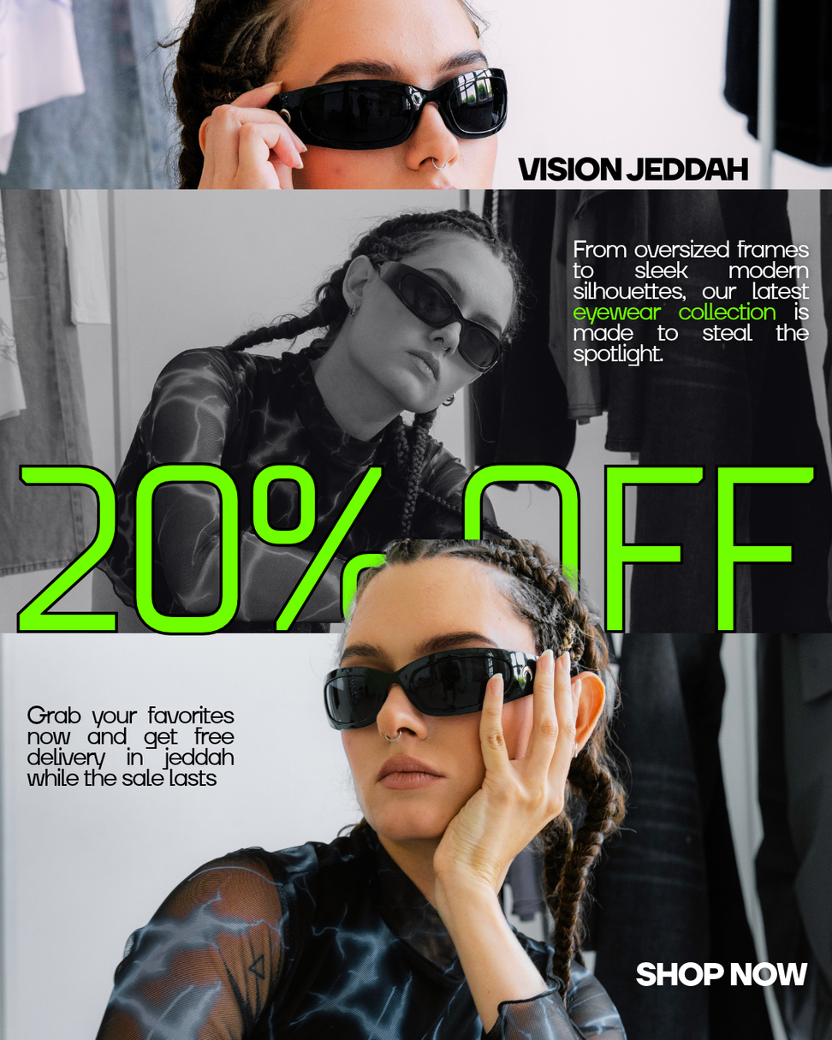
ارتقِ بإطلالتك اليومية مع مجموعة النظارات الجديدة لدينا. 🕶️✨
من الإطارات العريضة إلى التصاميم الأنيقة، اكتشف الزوج المثالي الذي يخطف الأنظار.
توصيل مجاني داخل جدة!
Elevate your everyday look with our new eyewear collection. 🕶️✨
From oversized frames to sleek silhouettes, find the perfect pair to steal the spotlight.
🚚 Free Delivery inside Jeddah!

Slide 3
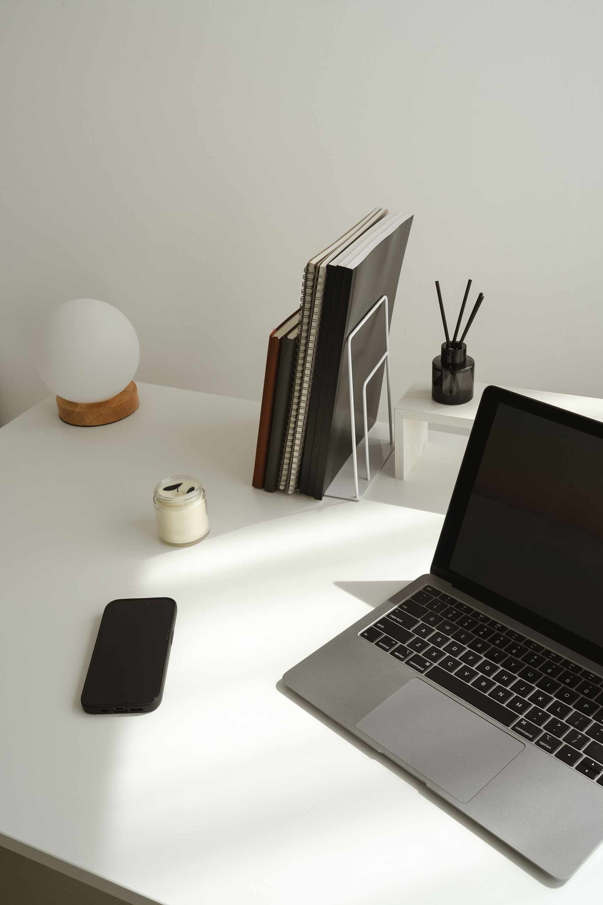
Targeting Strategy
  Campagin Objectives: Sales
  Location: Jeddah, Saudia Arabia
  Audience:Men &Women, Age 18-35
  Interest: Fashion, Eyewear, Luxury Brands, Shopping
  Placements: Instagram Feed & Stories

Slide 4

Budget & Forcasting
  Monthly Budget: $500
  Estimated Cost Per Click: $0.50
  Estimated Clicks: 1,000
  Expected Conversion Rate: 2%
  Projected Order: 20
  Targeted Cost Per Acquisition: $25

